Slide 1


Installation
OneClick Go! Version 2.7
How to get OneClick Go! installed on your computer? Before installing, make sure that your system meets the minimum system requirements.
Run OneClick_Go_Final_Release_Setup.exe and follow the instructions.
Allow the Setup if prompted for administrative privileges. Click Next to continue installation. Read the license agreement and select ‘I accept the agreement’ if you agree with the terms and conditions. Now click Next to continue installing OneClick Go! Select the folder for the installation of program files for OCG and then click Next. Select the Program Group in start menu or click Don’t create a start menu folder if you don’t want one. If you want a desktop shortcut for OCG, then check the checkbox of Create a desktop icon. Click Next and then Install.
After that, the installation will begin. It will take time depending on your system configuration and the load on processor at the time of installation. You can launch the program as soon as the installation get completed.

Slide 2
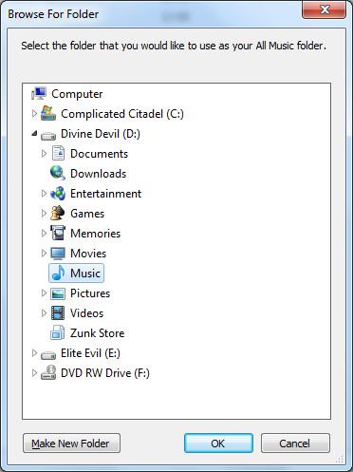
First Run
OneClick Go! Version 2.7
Congratulations! You have OCG installed on your system. On the very first run of OCG, it is recommended that you close any instance of windows media player.
Now you are ready to experience the change in your media management.
Because it is the first run of OCG on your machine, you need to tell it the folder where you preserve your ‘All Music’ that means the folder where the collection apart from your favorite music lies. Of course, it is compulsory to provide that information. Later, it will ask for your music, i.e. ‘My Music’ folder. If you don’t have one, then it is highly recommended that you create a new folder for that. Note that the folders should contain MP3 in themselves (not in any subfolder). So, please put all files in one folder before running OCG.
After retrieving essential information from you, it will start loading the elements into its library. And once it is done, you can start building your playlist. Select a song in All Music, listen to it (optional) and if you like it, then press the space key to add that to your music. Enter the desired rank of the song and press enter. Don’t forget to save your list.

